Slide 1
PBU Walls(TMP Grids)
TERRAHL2-FP_MB-T1am(JMB)

Slide 2
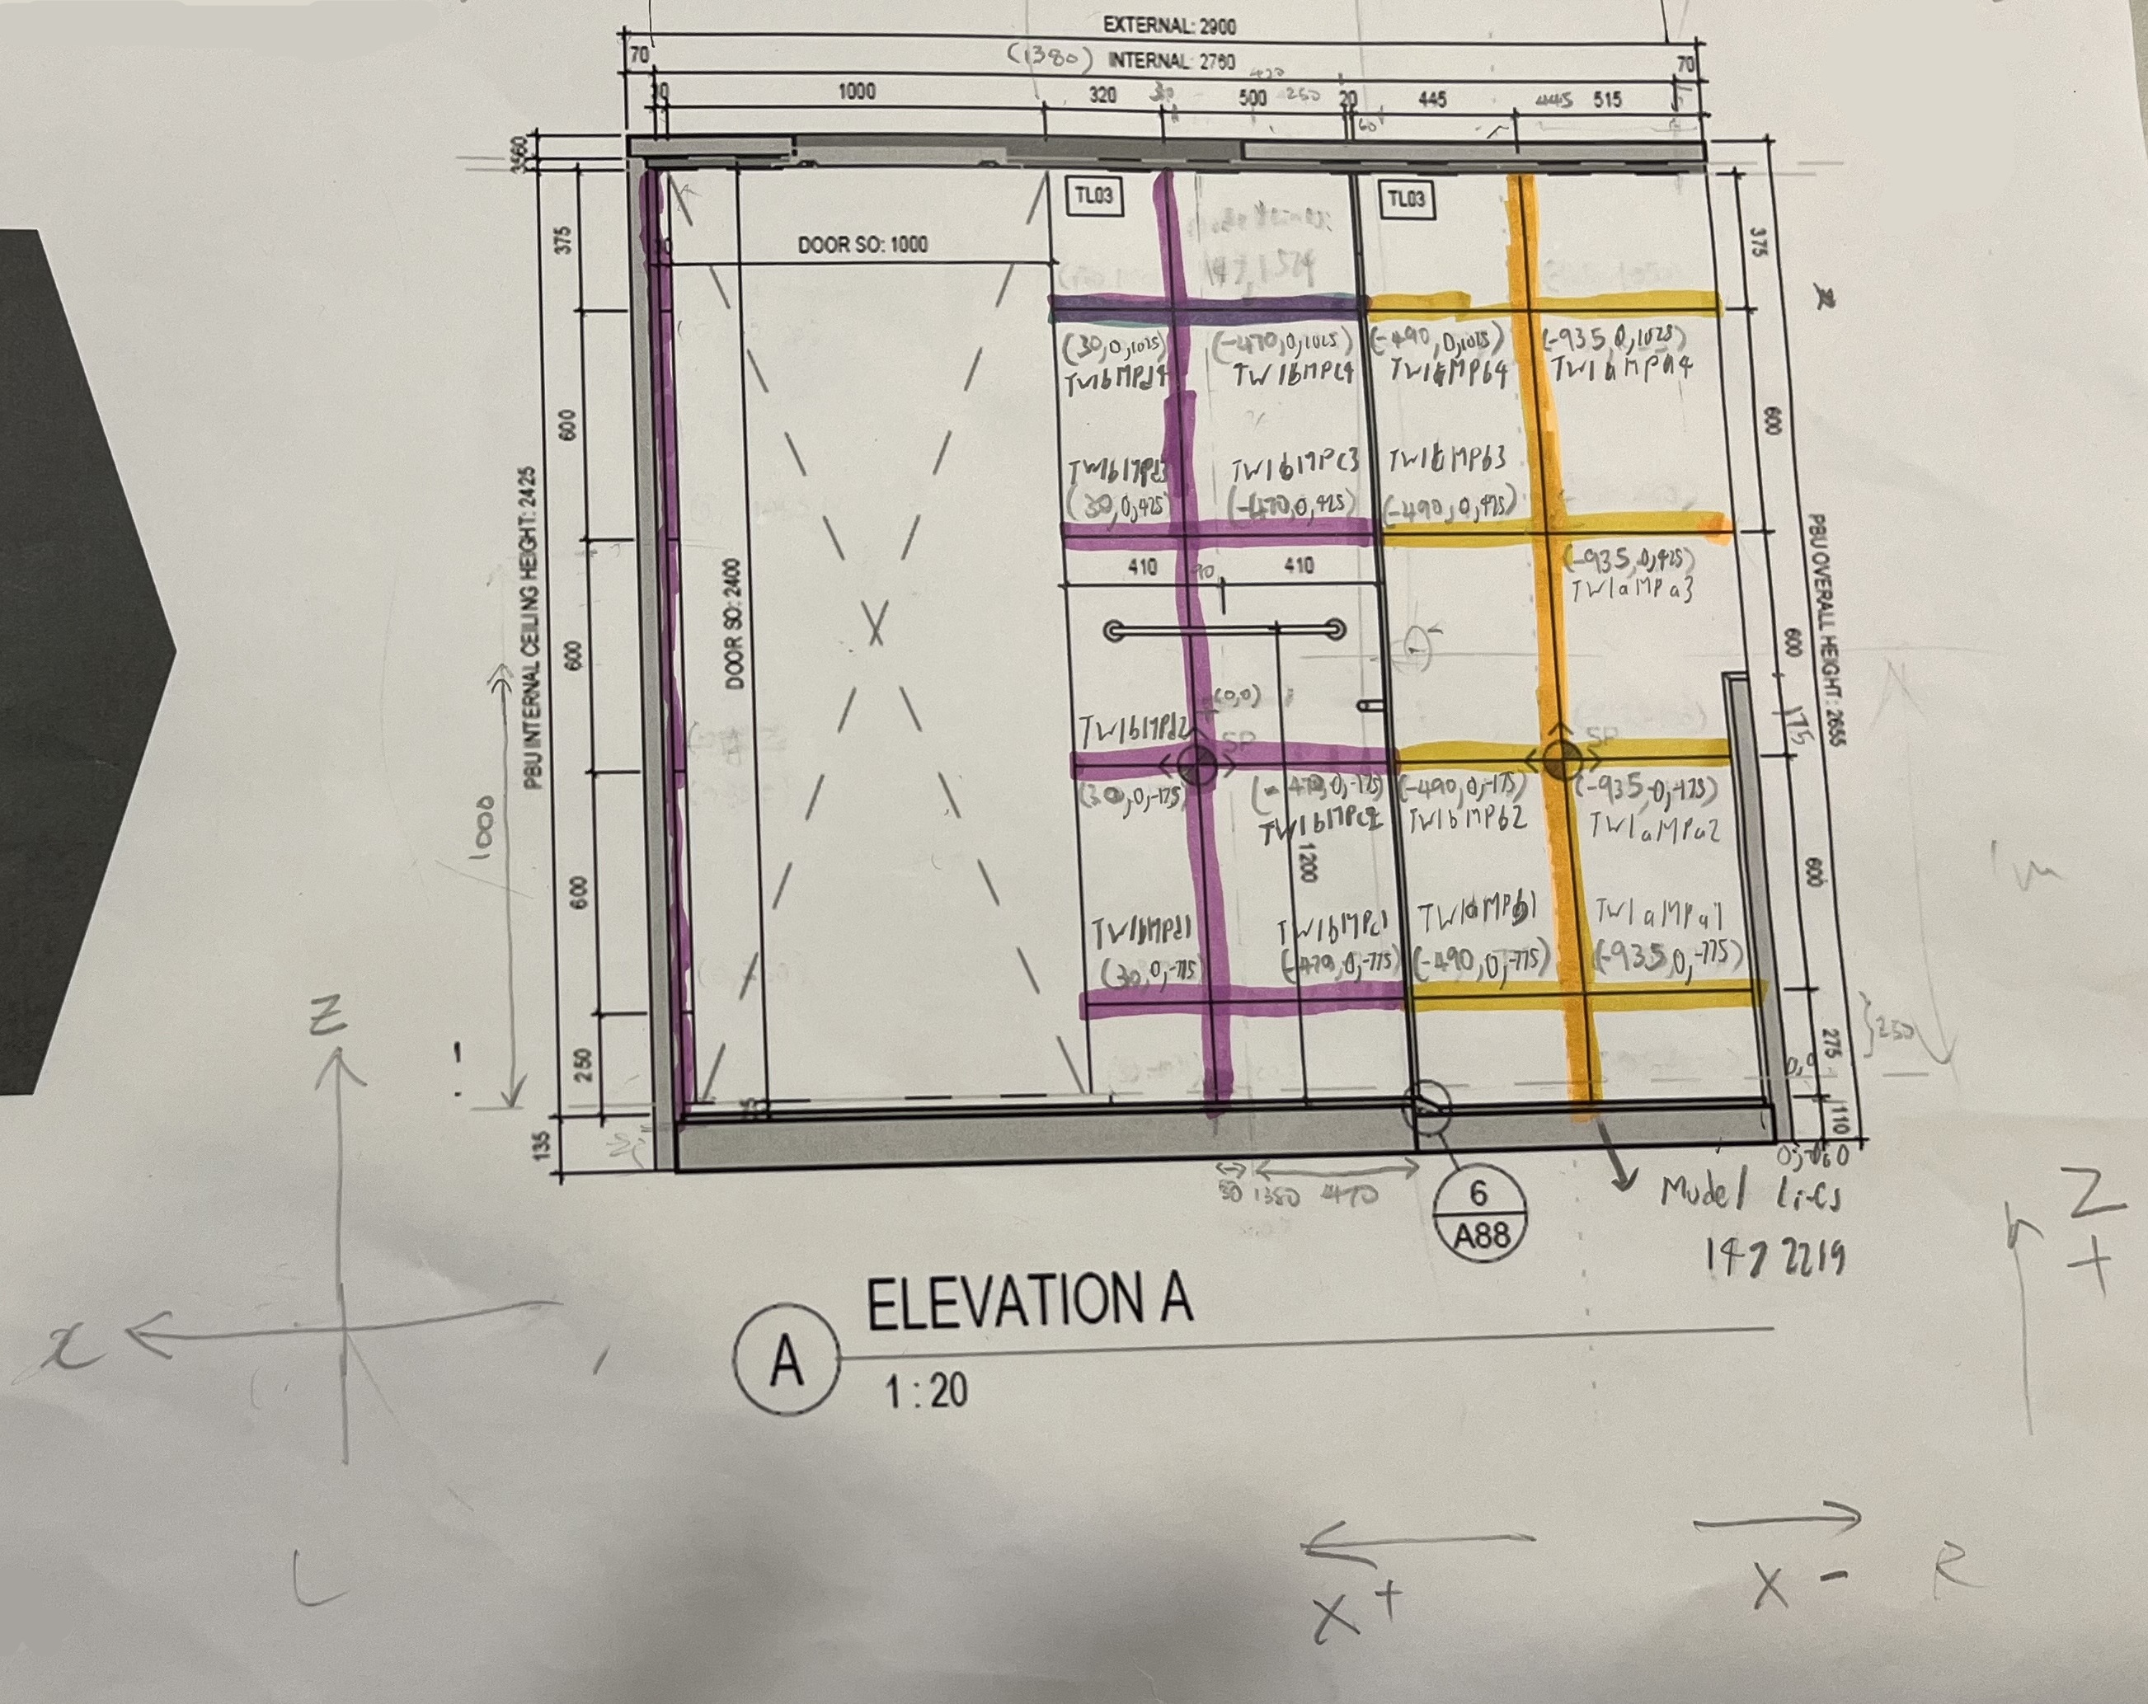
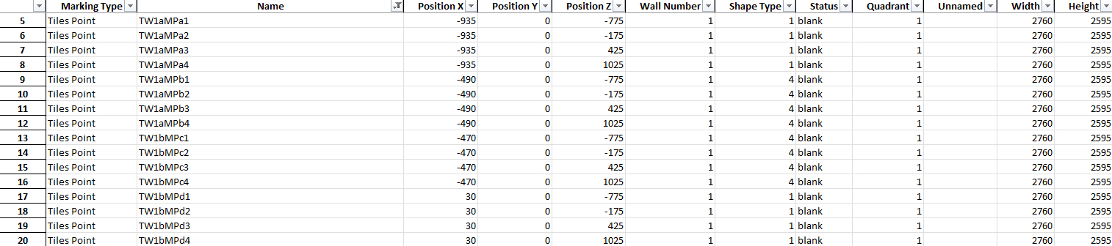
Wall 1

Slide 3
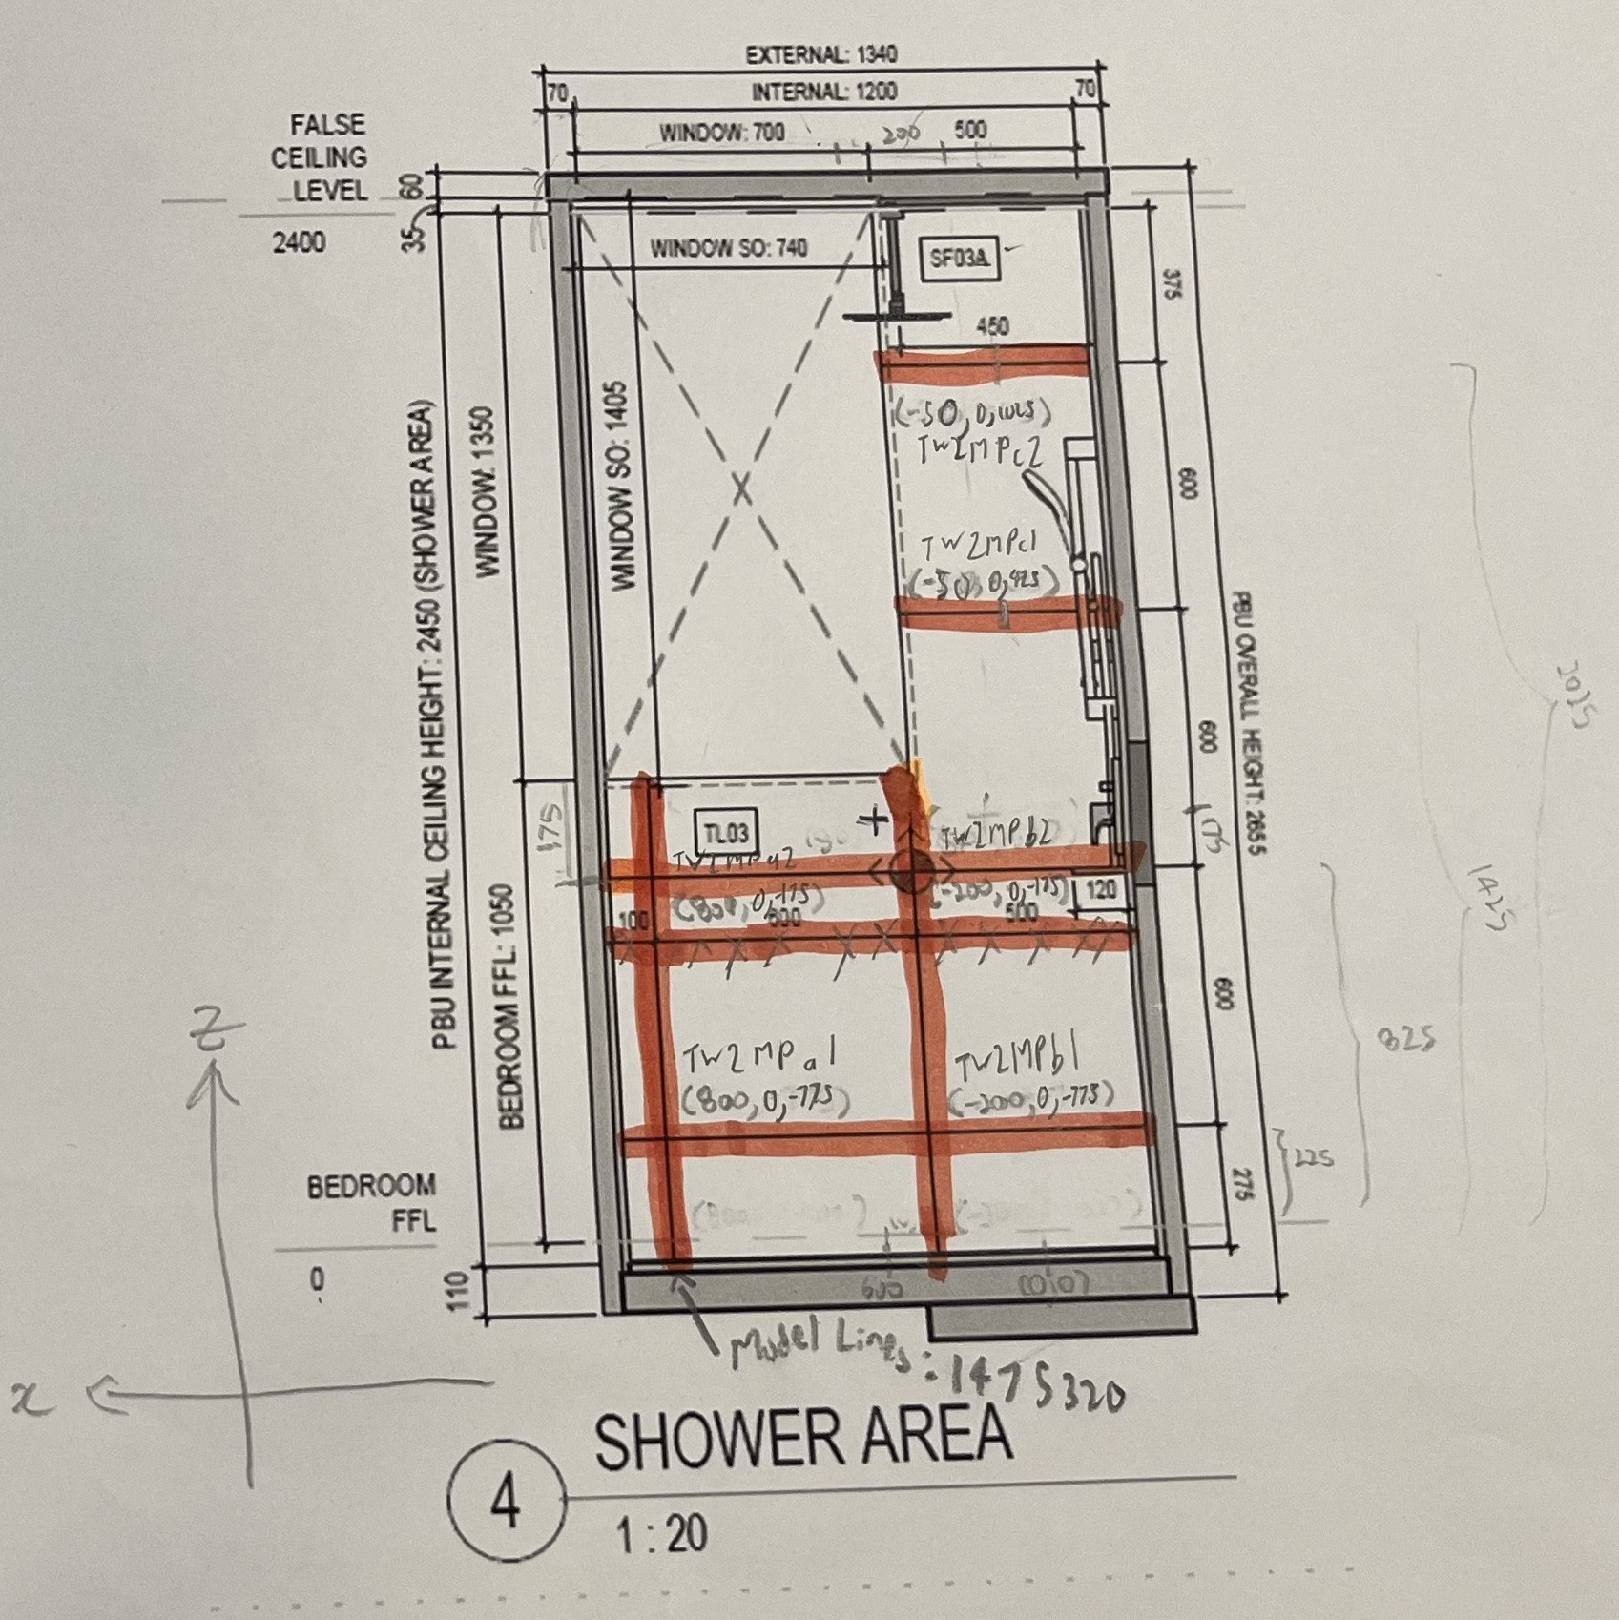
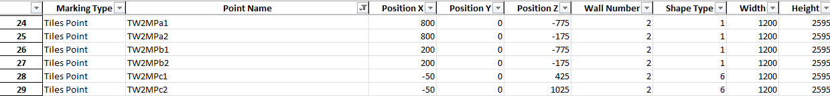
Wall 2

Slide 4
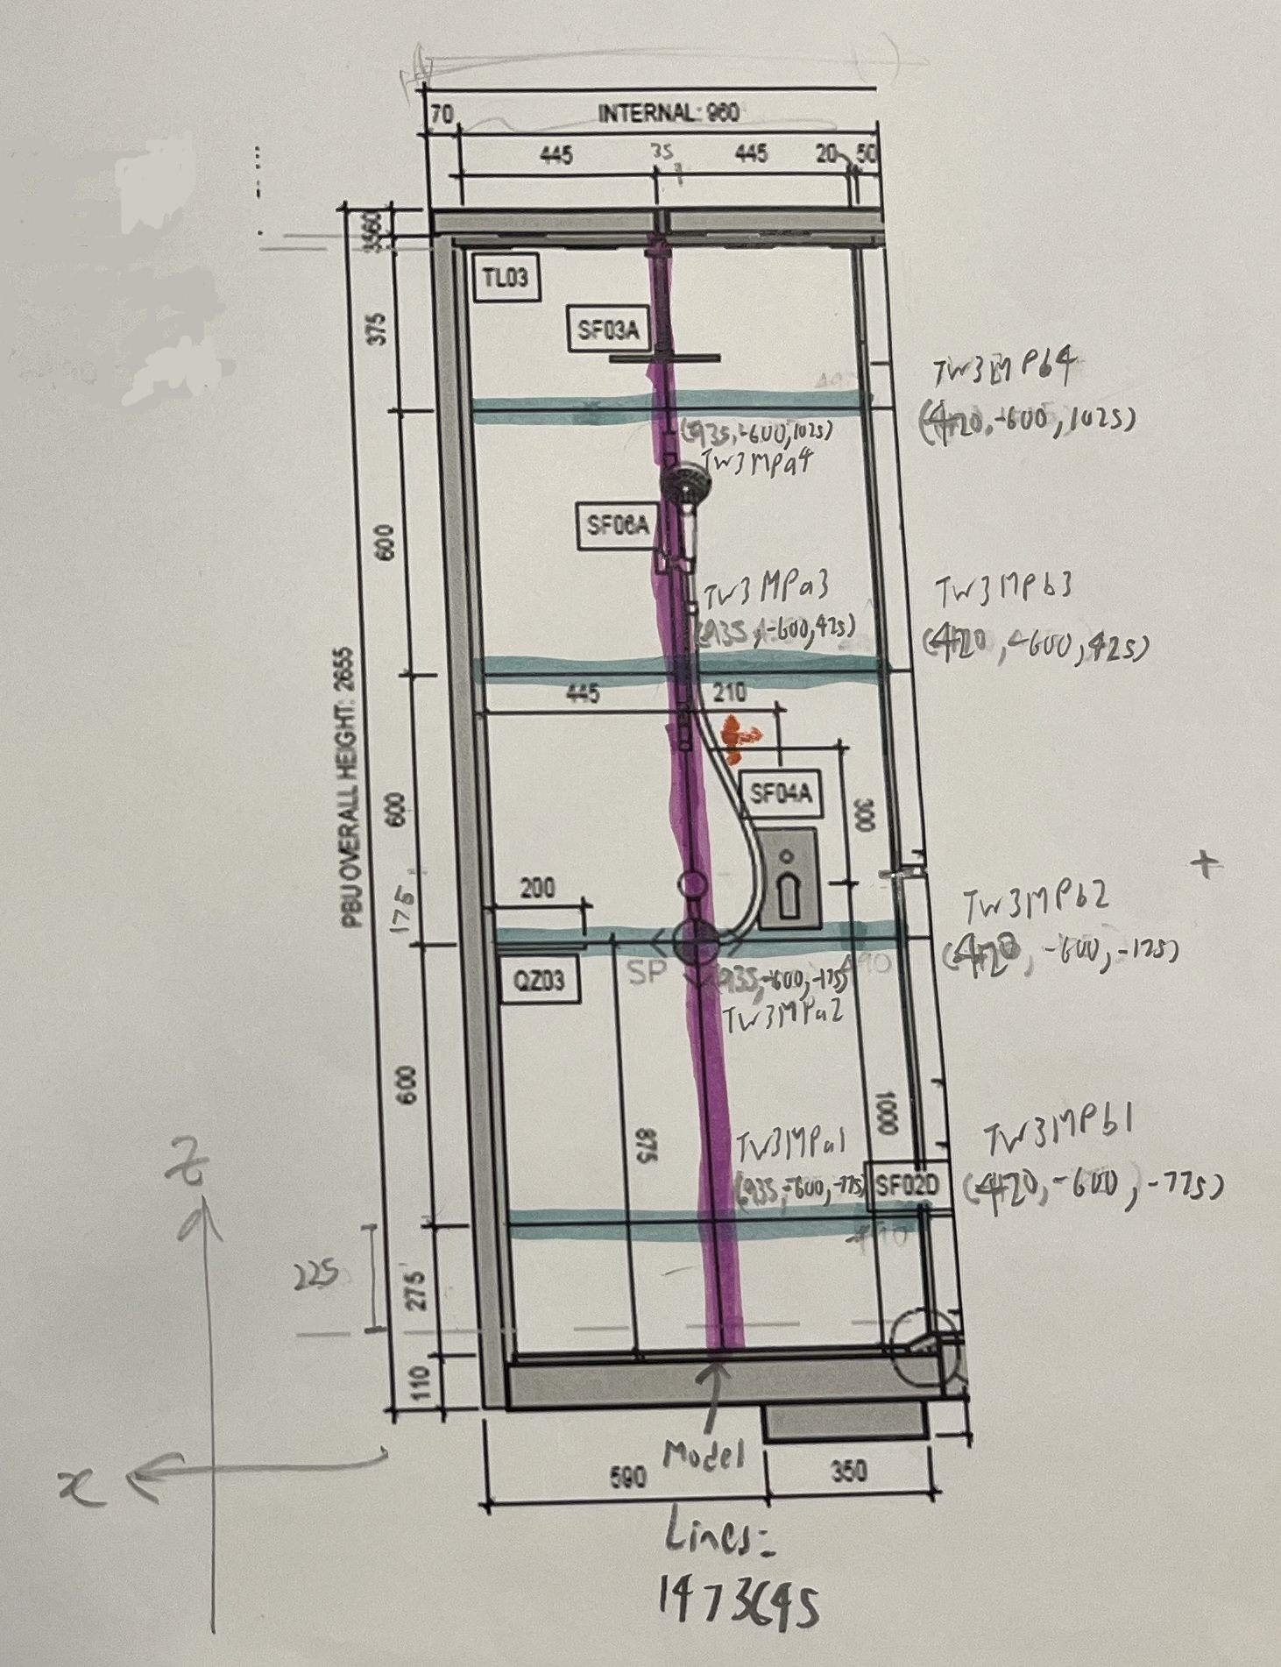
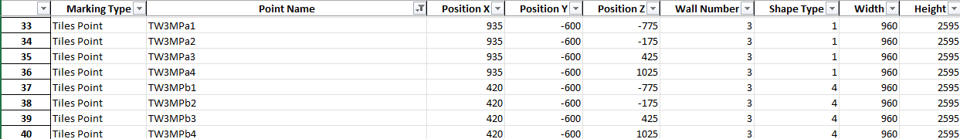
Wall 3
Center Line of X is at Wall 5 since it is at Elevation C.

Slide 5
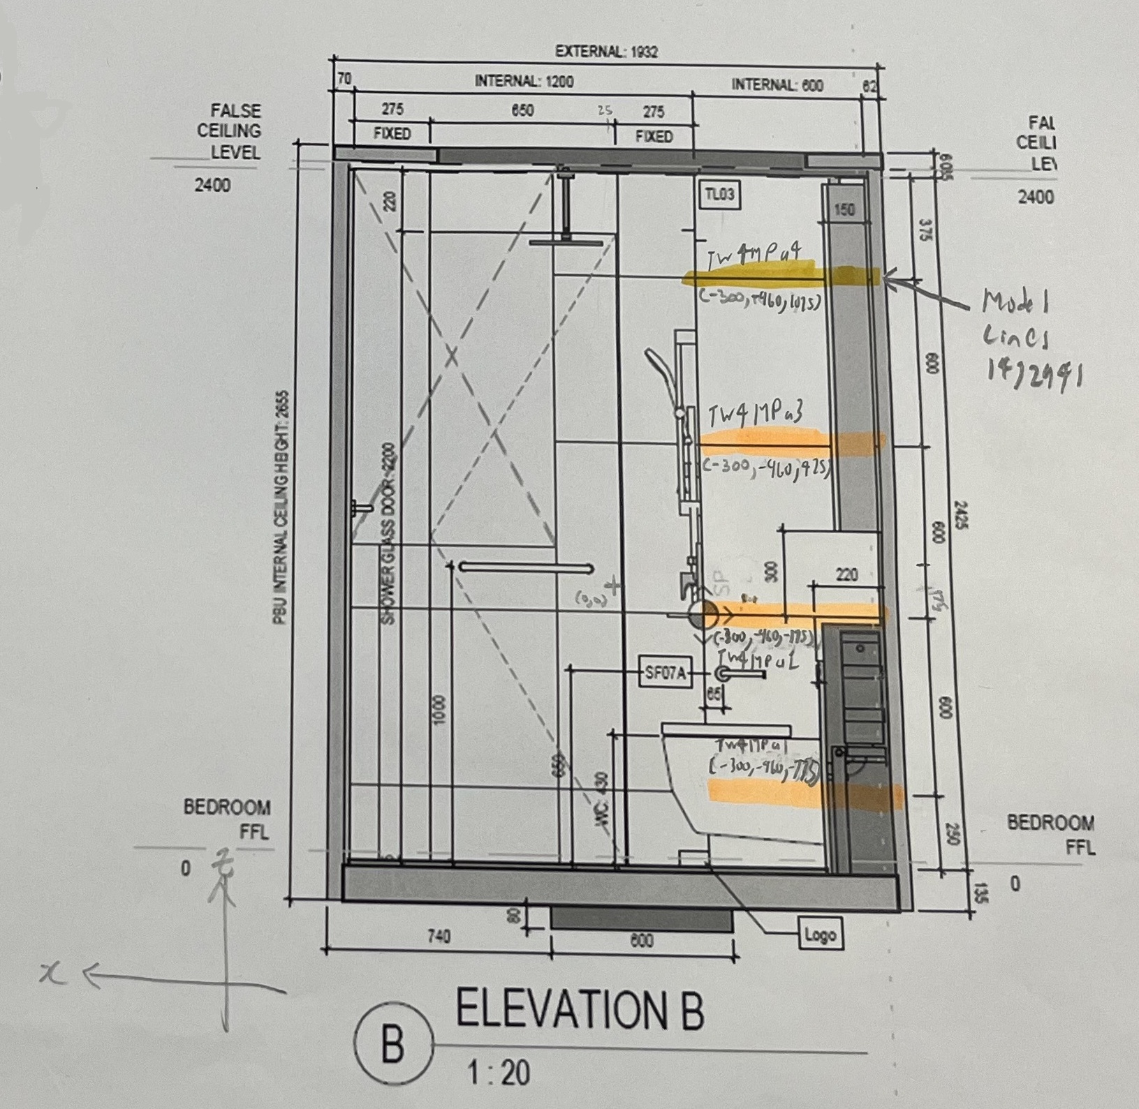
Wall 4

Slide 6
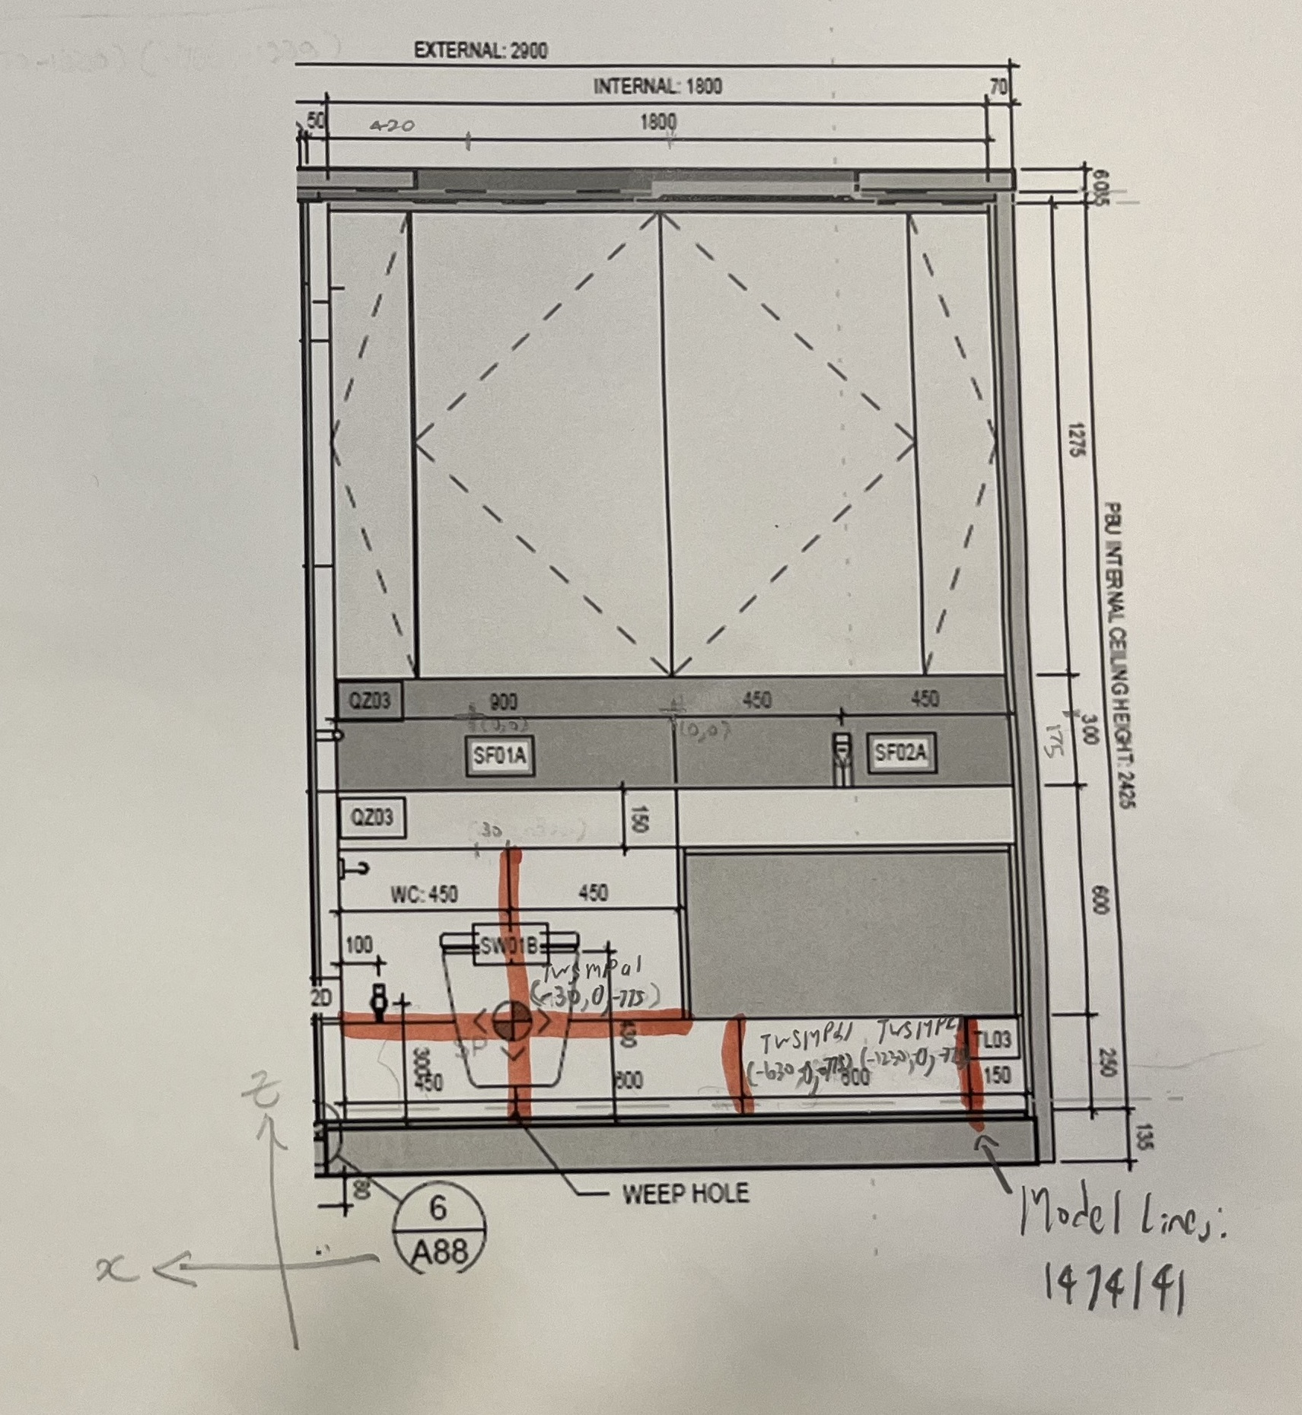
Wall 5
Center Line of X for Wall 3 and Wall 5 since it is at Elevation C.

Slide 7
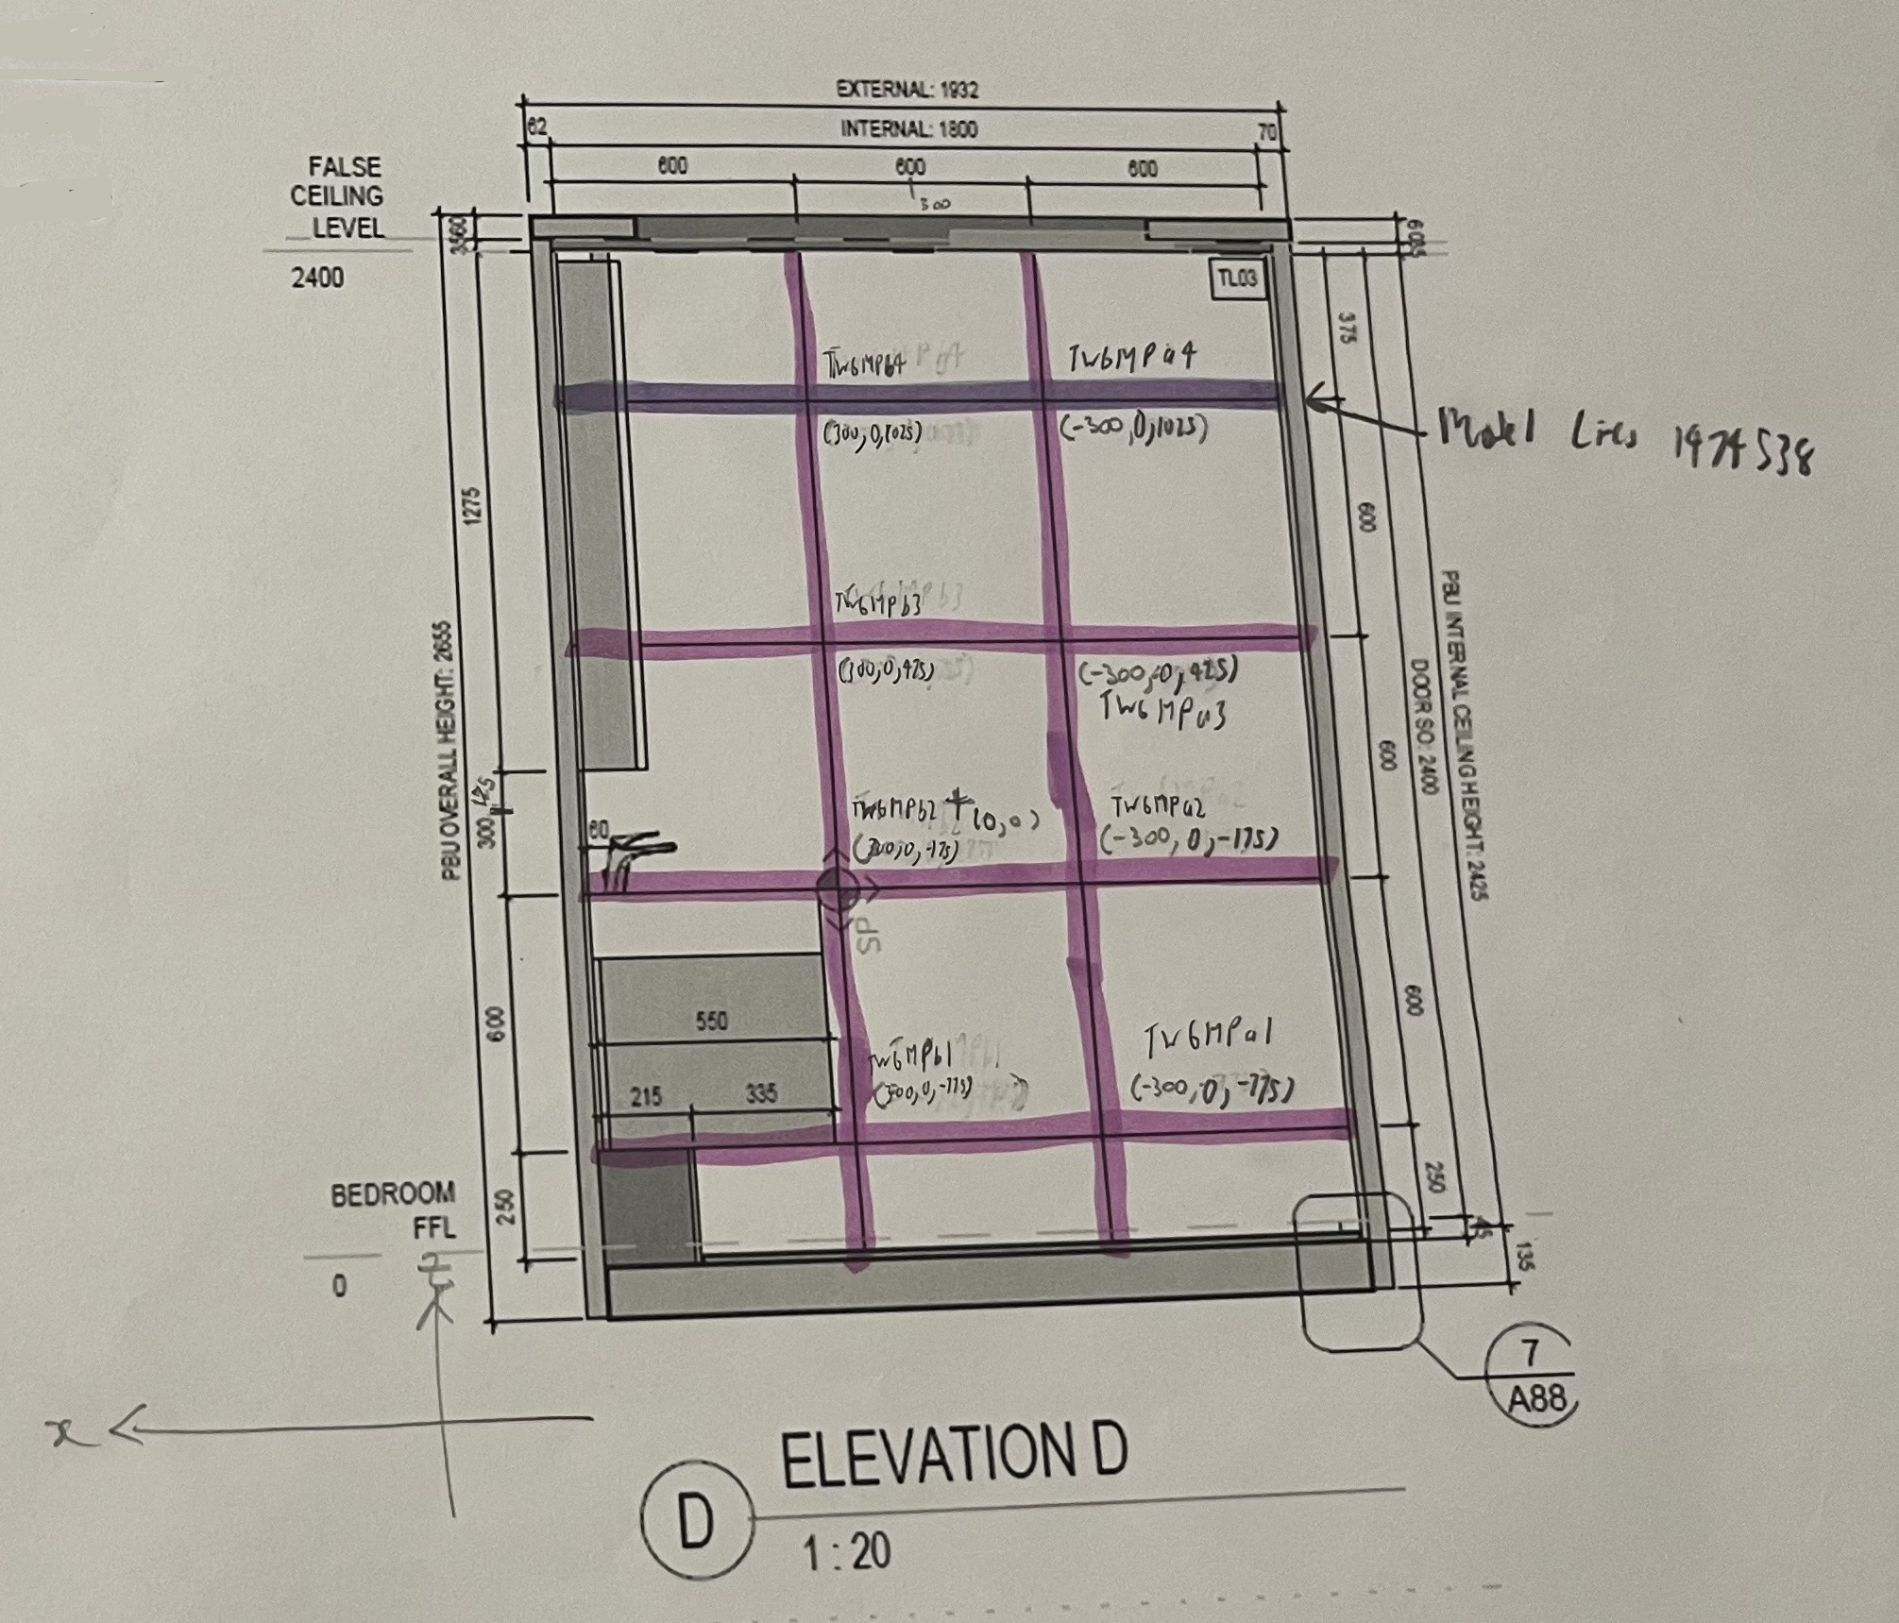
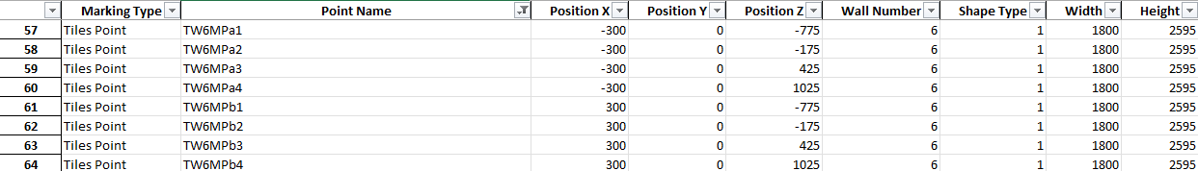
Wall 6

Slide 8
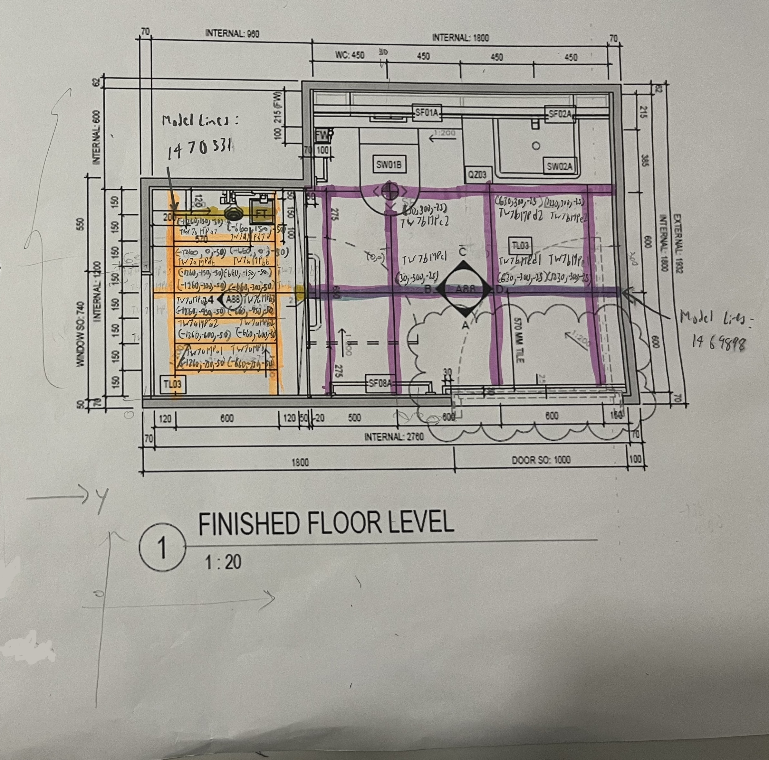
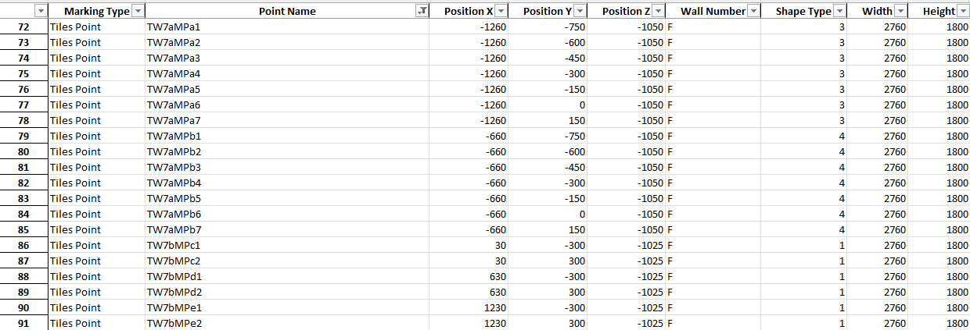
Floor
TW7aMPa5
TW7aMPb5
TW7aMPa4
TW7aMPb4

